Slide 2
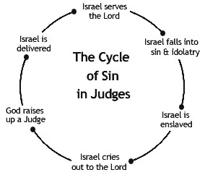
Judges 2:1-13
Judges 6:15

Slide 3
GOD CALLED GIDEON FOR HIS SERVICE WHO WAS A WORKER
God wants Workers in His service – John 9:4
  Philippians 2:12,13
  Matthew 25:26-30
Gideon Not Chosen Because of Wealth or Rank
  1 Corinthians 1:26
  Church not stacked with Wealth and Success

Slide 4
GIDEON SOUGHT ASSURANCE FROM GOD
Knew task of overthrowing the Midianites impossible without God
Wanted to be sure he wasn’t acting on his own initiative – Judges 6:17-21

Slide 5
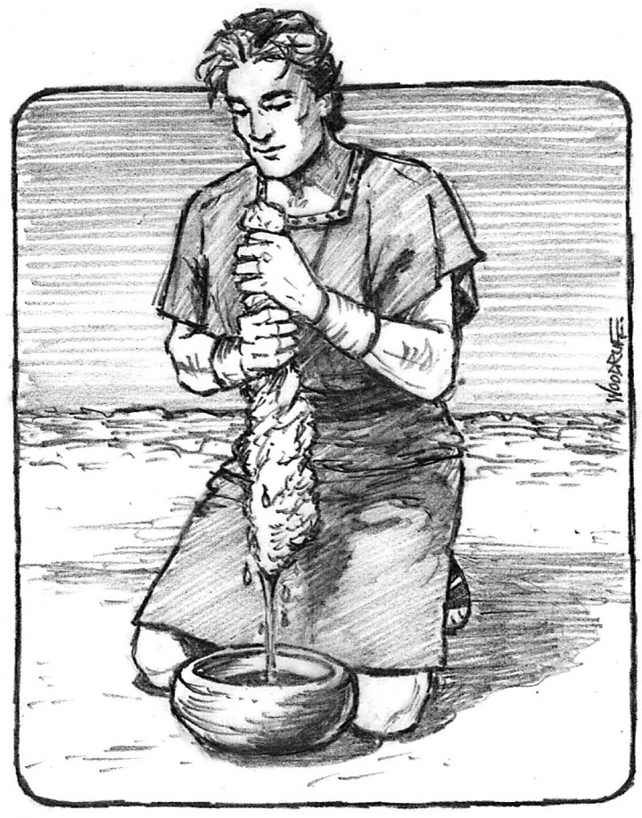
GIDEON SOUGHT ASSURANCE FROM GOD
Judges 6:36-40
Judges 21:25
Proverbs 14:12
Isaiah 55:8,9
1 John 2:3,4

Slide 6
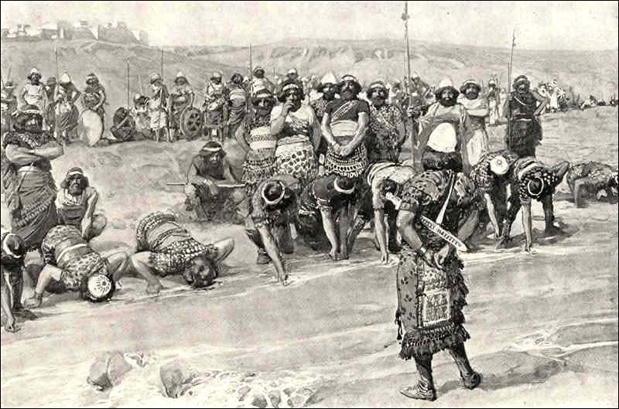
GIDEON WAS A MAN OF FAITH
Selection of his army – Judges 7:2-8

Slide 7
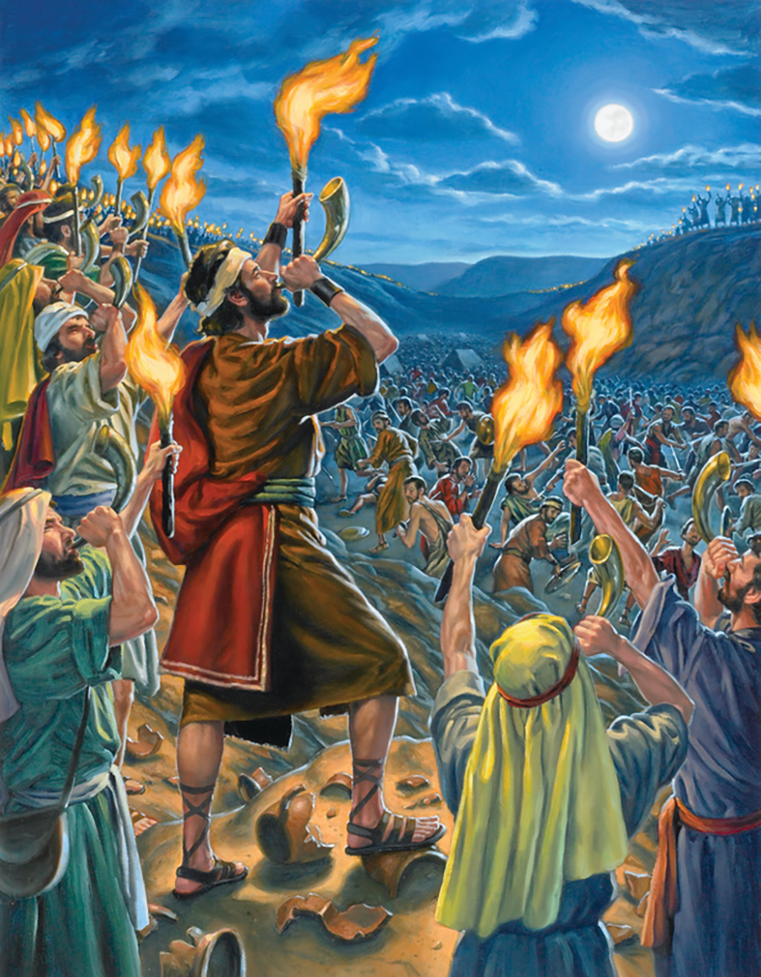
GIDEON WAS A MAN OF FAITH
Strategy of the Battle – Judges 7:16-22
Numerical Odds Too Great – 135,000 to 300!
1 John 5:3,4

Slide 8
GIDEON WAS A MAN OF COURAGE
Took courage to tear down altar of Baal and build an altar to God
We need courage today to act upon what God says
Even if it goes contrary to our parent’s religion
Or contrary to influential people

Slide 9
GIDEON GAVE HONOR AND GLORY TO GOD
Didn’t seek his own interests- Judges 6:24
Judges 7:13-15
Judges 8:22,23
Gideon worshiped God
Wanted others to worship Him

Slide 10
Hebrews 11:32
Truly Gideon is a hero of Faith; may we so stand if we will cultivate these characteristics in our own lives

